Slide 1
S-NPP Science Team Update and SIPS Selections; Continuity of NASA Data Products
Jim Gleason
NASA Goddard Space Flight Center
Suomi NPP Project Scientist
JPSS Senior Project Scientist
Second Suomi NPP Applications Workshop
November 18-20, 2014

Slide 2
Agenda
Conclusions of ROSES-10 Science Team
New ROSES-13 Science Team

Slide 3
Suomi NPP Status
Launch October 28, 2011 Three years old!
Spacecraft, Instruments and Ground system are in Nominal operations
S NPP operated by NOAA.
4th and last Inclination Maneuver Planned for Nov 20
Next VIIRS Lunar Roll 2 Dec 2014
Operational Data Products and Algorithm Code available from: www.class.noaa.gov
NASA Research Products available by discipline
NASA call for standard products selections announced.

Slide 4
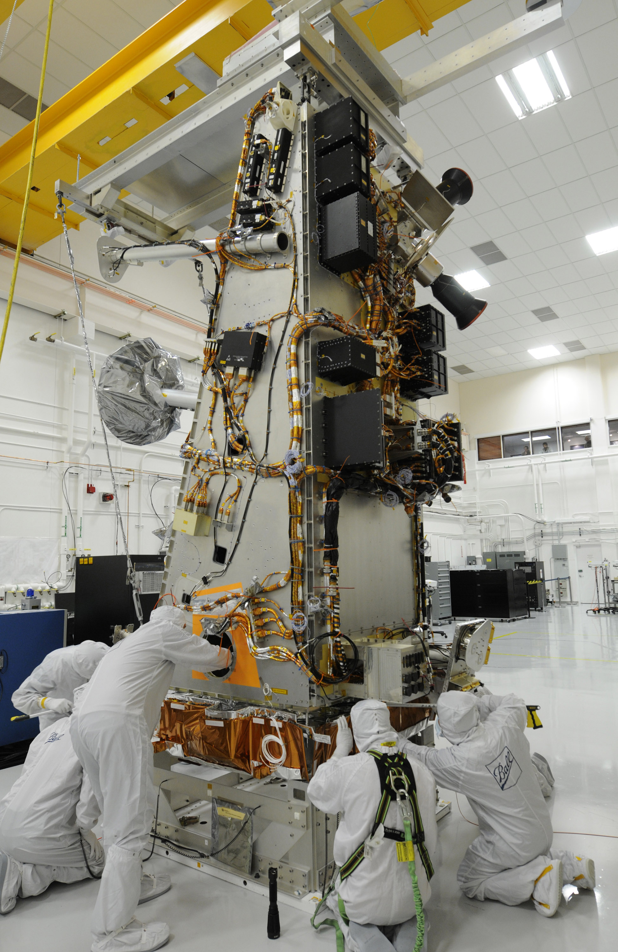
JPSS 1 Status
Launch; Late 2016/Early 2017
Spacecraft: Assembled and in test. Instrument Integration Reviews ready to start
Instruments
OMPS and CERES delivered
VIIRS: TVAC complete,
post-TVAC underway,
PSR early Jan 2015
CrIS: In TVAC. PSR Feb 2015
ATMS: Significant Post-TVAC
rework

Slide 5
Suomi NPP: NASA Science Team
(36 members selected in 2010)
The Suomi NPP Science Team was re-competed in ROSES-2010; its research is focused on supporting work to ensure the continuity of scientific data records started in the EOS era.
The Suomi NPP Science Team’s work on data products will focus on SDR and EDR evaluation and, if needed, improvement.* Science Team recommendations for algorithm improvement will forwarded to JPSS/NOAA through the NPP Project Science Office.
The Suomi NPP Science Team has 5 subgroups working together:
-- VIIRS Cloud/Aerosol/Atmosphere -- Ozone
-- VIIRS Land -- Sounder
-- VIIRS Ocean
A few Suomi NPP Science Team members are working on cal/val support activities or the conceptual basis for new products.
* Exceptions: CERES data products will be produced and archived by existing CERES team and OMPS Limb data products will be developed, produced, and archived by NASA/NOAA Ozone Team.

Slide 6
ROSES-10 Science Team Results
Eight reports produced, Ocean (SST & Ocean Color), Land, Atmosphere (Clouds & Aerosols), Ozone (Nadir and Limb), Sounder
Available at: http://npp.gsfc.nasa.gov/teaminfo.html
Common Themes
All the NPP Instruments are working well.
NPP Level 1 data are suitable for data continuity
Suomi NPP can be used to produce EOS Products not produced by IDPS
Continuous, un-interrupted instrument calibrations are required for climate studies
Data reprocessing required for producing consistent time series data sets.
Level 3 Gridded Products essential for analysis
Evaluation Phase Complete

Slide 7
ROSES-10 Science Team Results Ozone
IDPS EDRs similar to EOS data products/similar algorithm.
Total Ozone Algorithms
IDPS based on TOMS V7
PEATE EDR is TOMS V8
TOMS V7 perfectly fine
for operational use.
Known systematic errors
when trying to connect
V7 and V8 data sets
Ozone data sets begin in 1978
Corrected IDPS implementation agrees to within ±3% globally (~1% is usually achieved)
Differences with latitude remain due to limited profile shape correction and different cloud height methodology
Credit: Rich McPeters/NASA GSFC

Slide 8
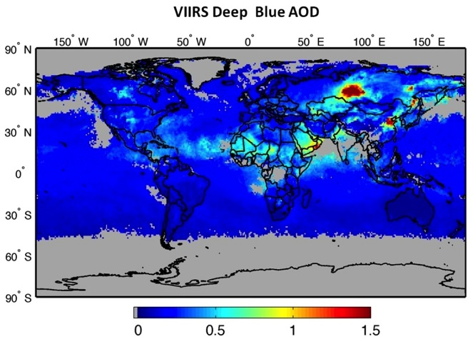
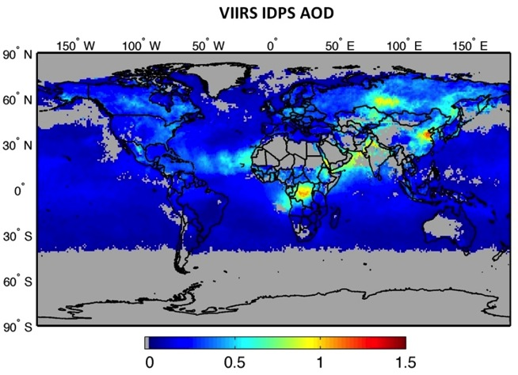
ROSES-10 Science Team Results Atmosphere - Aerosols
Suomi NPP can be used to produce EOS Products not produced by IDPS
Comparisons of Monthly Mean of VIIRS Deep Blue AOD with VIIRS IDPS for July 2012
VIIRS DB retrieves aerosols over desert and semi-desert regions, which are entirely missing in VIIRS IDPS AOT products.
Credit: Christina Hsu/NASA GSFC

Slide 9
Suomi NPP Proposals Solicited
This solicitation requested:
1. Proposals from members of the scientific community to participate in the NASA Suomi NPP Science Team
Development of science quality standard data products using Suomi NPP measurements that will enable continuity of key standard Earth system data records from NASA’s EOS Terra, Aqua, and/or Aura satellites
Development and demonstration of innovative and practical applications of Suomi NPP measurements
Development of other new science data products from Suomi NPP measurements that will meet high-priority Earth science needs
A Suomi NPP Discipline Leads
2. Proposals for the establishment of Science Investigator-led Processing Systems (SIPS) to produce NASA Suomi NPP standard and experimental science data products

Slide 10
ROSES-2013 A.29 Suomi NPP Statistics
Proposals Due: March 10, 2014
Number Proposals Received: 119
Selection Date: August 12, 2014
Proposals Selected: Science Team - 40 of 113; SIPS - 5 of 6
Science Team PI Distribution (35% success rate):
Universities 17 Other Gov’t. Agency 3
NASA Centers 15 Non-Profit: 1
For-Profit Corp. 4
Product Type Distribution:
EOS Continuity Products (includes cal/val) 35
Innovative and Practical Applications: 2
Other Products 3
SIPS PI Distribution (83% success rate):
Universities 1 NASA Centers 4

Slide 11
Balance Across Science Team Topics
Standard Products from Suomi NPP for EOS Continuity: 35 proposals (including 4 focused on cal/val)
Land; including Snow/Ice: 11 proposals
Ocean; SST: 3 Ocean Color: 6 including atmospheric correction
Atmosphere (Clouds & Aerosols) 7 proposals
Ozone; 3 proposals
Sounder; 4 proposals
Innovative and Practical Applications of Suomi NPP Data: 2 proposals; Agricultural Monitoring, Air Quality & Public Health
Other Data Products: 3 proposals, VIIRS Night Lights, CrIS NH₃ & CO, Ocean Color Data Assimilation

Slide 12
NASA Distributed Data Processing
Government Resource
for Algorithm
Verification Independent
Testing & Evaluation
(GRAVITE)
Ozone
Limb Community
Sounder
Science Investigator
Processing System
(SIPS)
Archive &
Distribution
Segment
(ADS) / CLASS
SDS Data Distribution &
Depository Element
(SD3E)
Ozone
Science Investigator
Processing System
(SIPS)
Limb SDR (EV+CAL) and EDR
Interface Data
Processing
Segment (IDPS)
Atmosphere
Science Investigator
Processing System
(SIPS
OMPS Limb RDRs
Land
Science Investigator
Processing System
(SIPS
Data flow
OMPS Limb Data Flow
NPP
Science
Team
VIIRS Cal/Val Interaction
Ocean
Science Investigator
Processing System
(SIPS
EDR assessment
CERES RDR, VIIRS SDR, AOT
VIIRS Instrument
Calibration Support
Team (VCST)
Earth Radiation Budget
Climate Analysis Research
System
(ERBCARS)
Science Data Segment
CERES
Science Community
The Suomi NPP Science Data Segment is a System of Systems distributed amongst: 9 facilities located at GSFC, JPL, U of Wisconsin, & LaRC
LaRC DAAC

Slide 13
Polar-Orbiting Operational Satellites
FY | 2010 |  |  | 2011 |  |  |  | 2012 |  |  |  | 2013 |  |  |  | 2014 |  |  |  | 2015 |  |  |  | 2016 |  |  |  | 2017 |  |  |  | 2018 |  |  |  | 2019 |  |  |  | 2020 |  |  |  | 2021 |  |  |  | 2022 |  |  |  | 2023 |  |  |  | 2024 |  |  |  | 2025 |  |  |  | 2026 |  |  |  | 2027 |  |  |  | 2028 |  |  |  | 2029 |  |  |  | 2030
 | Q2 | Q3 | Q4 | Q1 | Q2 | Q3 | Q4 | Q1 | Q2 | Q3 | Q4 | Q1 | Q2 | Q3 | Q4 | Q1 | Q2 | Q3 | Q4 | Q1 | Q2 | Q3 | Q4 | Q1 | Q2 | Q3 | Q4 | Q1 | Q2 | Q3 | Q4 | Q1 | Q2 | Q3 | Q4 | Q1 | Q2 | Q3 | Q4 | Q1 | Q2 | Q3 | Q4 | Q1 | Q2 | Q3 | Q4 | Q1 | Q2 | Q3 | Q4 | Q1 | Q2 | Q3 | Q4 | Q1 | Q2 | Q3 | Q4 | Q1 | Q2 | Q3 | Q4 | Q1 | Q2 | Q3 | Q4 | Q1 | Q2 | Q3 | Q4 | Q1 | Q2 | Q3 | Q4 | Q1 | Q2 | Q3 | Q4 | Q1 | Q2 | Q3 | Q4
 |  |  |  |  |  |  |  |  |  |  |  |  |  |  |  |  |  |  |  |  |  |  |  |  |  |  |  |  |  |  |  |  |  |  |  |  |  |  |  |  |  |  |  |  |  |  |  |  |  |  |  |  |  |  |  |  |  |  |  |  |  |  |  |  |  |  |  |  |  |  |  |  |  |  |  |  |  |  |  |  |  |  | 13
GCOM W-1
GCOM W-2/3
End of Program
NASA L1
70%
POL
OMPS Nadir-only
NPP
OMPS Nadir & Limb
Potential Gap
JPSS-1
(NLT 2QFY2017)
JPSS-2
Aqua
(1QFY2022)
Aura
TCTE
SORCE
NOAA 19
A-DCS and SARSAT (User Services) are manifested
A-DCS (User Services) is manifested
MetOp-A
MetOp-B
EPS - SG
MetOp-C
-Launch Date
- Checkout / Calibration / Validation

Slide 14
Standard Products (Land)
EOS Standard Level 2 and Level 3 Land Data Products Selected for Suomi NPP:
Surface Reflectance (Vermote - #86; Next Generation: Lyapustin - # 96)
Snow Cover (Hall, D. - # 49)
Land Surface Temperature and Emissivity (Hulley - # 106)
Land Cover and Dynamics (Dynamics only: Zhang, X - # 87)
Vegetation Indices (Didan - # 68)
Fire and Thermal Anomalies (Schroeder - # 29)
Leaf Area Index (LAI) and Fraction Absorbed Photosynthetically Active Radiation (FPAR) (Myneni - # 9)
Sea Ice Cover and Ice Surface Temperature (Hall, D. - # 49)
BRDF (Bi-directional Reflectance Distribution Function) / Albedo (Schaaf - # 94)
Vegetation Continuous Fields No selection
Burned Area (Giglio - # 35)

Slide 15
Standard Products (Ocean)
EOS Standard Level 2 and Level 3 Ocean Data Products Selected for Suomi NPP:
Sea Surface Temperature (Minnett - # 79; Next Generation: Harris - # 41 and Wentz – # 19)
Aerosol Angstrom Exponent (Franz - #77)
Aerosol Optical Thickness (Franz - #77)
Subsurface Chlorophyll a Concentration (Gregg - # 38; Hu - # 64; Franz- # 77)
Diffuse attenuation at 490 nm (Lee - # 56; Franz - # 77)
Photosynthetically Available Radiation (Frouin - # 3)
Particulate Inorganic Carbon (Balch - # 33)
Particulate Organic Carbon No selection
Remote Sensing Reflectance (Hu - # 64; Franz - # 77)

Slide 16
Standard Products (Atmosphere)
EOS Standard Level 2 and Level 3 Atmosphere Data Products (from MODIS) Selected for Suomi NPP:
Aerosol Product (Levy - # 43; Hsu - # 20; Next Generation: Lyapustin - # 96)
Total Precipitable Water (Water Vapor) (Borbas - # 73)
Cloud Product (Platnick - #26; Baum - #1; Gao - # 45)
Atmosphere Profiles (total column ozone, water vapor) No selection
Atmosphere Gridded Product No selection
Cloud Mask (Platnick - # 26)

Slide 17
Standard Products (Ozone)
EOS Standard Level 2 and Level 3 Atmosphere Data Products (from OMPS) Selected for Suomi NPP:
Total Column Ozone (McPeters - #72)
Ozone Concentration Vertical Profiles (Bhartia - #21, McPeters - #72)
Aerosol Concentration Vertical profiles No selection
NO₂ Total Column (Yang - #13)
Sulfur Dioxide Total Column (Yang - #13)
Aerosols Total Column No selection

Slide 18
Standard Products (Sounder)
EOS Standard Level 2 and Level 3 Sounder Data Products Selected for Suomi NPP:
Atmospheric Temperature (vertical profiles) (Barnett - # 28, Susskind - # 99, Lambrigtsen, #39; Next Generation: Moncet - # 82)
Atmospheric Moisture (vertical water vapor profiles, total precipitable water, total cloud liquid water) (Barnett - # 28, Susskind - # 99, Lambrigtsen, #39; Next Generation: Moncet - # 82)
Atmospheric Pressure Vertical Profiles (None)
Surface Temperature (Barnett - # 28, Susskind - # 99, Lambrigtsen, #39; Next Generation: Moncet - # 82)
Cloud Properties (fractional cover, cloud top temperature, cloud top height) (Barnett - # 28, Susskind - # 99, Moncet - # 82)

Slide 19
Calibration & Validation Support
Calibration and validation of VIIRS Surface Reflectance product (Czapla-Myers, #66)
Validation of VIIRS thermal infrared data and products (Hook, #6)
Calibration of VIIRS against the moon (Stone, #104)
CrIS radiometric calibration under cloudy conditions (Aumann, #27)

Slide 20
Standard Products Not Selected
Atmosphere Profiles from VIIRS (total column ozone, water vapor)
Atmosphere Gridded Product
Land Cover
Vegetation Continuous Fields
Atmospheric Pressure Vertical Profiles
Particulate Organic Carbon
Aerosol Concentration Vertical Profiles and Total Column from OMPS

Slide 21
Innovative and Practical Applications Selected
Agricultural Monitoring Applications (Justice, #58)
Air Quality and Public Health Applications (Wang, J., #67)

Slide 22
Other New Science Data Products Selected
VIIRS Nighttime Lights (Elvidge, #120)
NH₃ and CO from CrIS (Cady-Pereira, #4)
Combine Data Assimilation with an Algorithm to Improve the Consistency of VIIRS Chlorophyll (Gregg, #38)

Slide 23
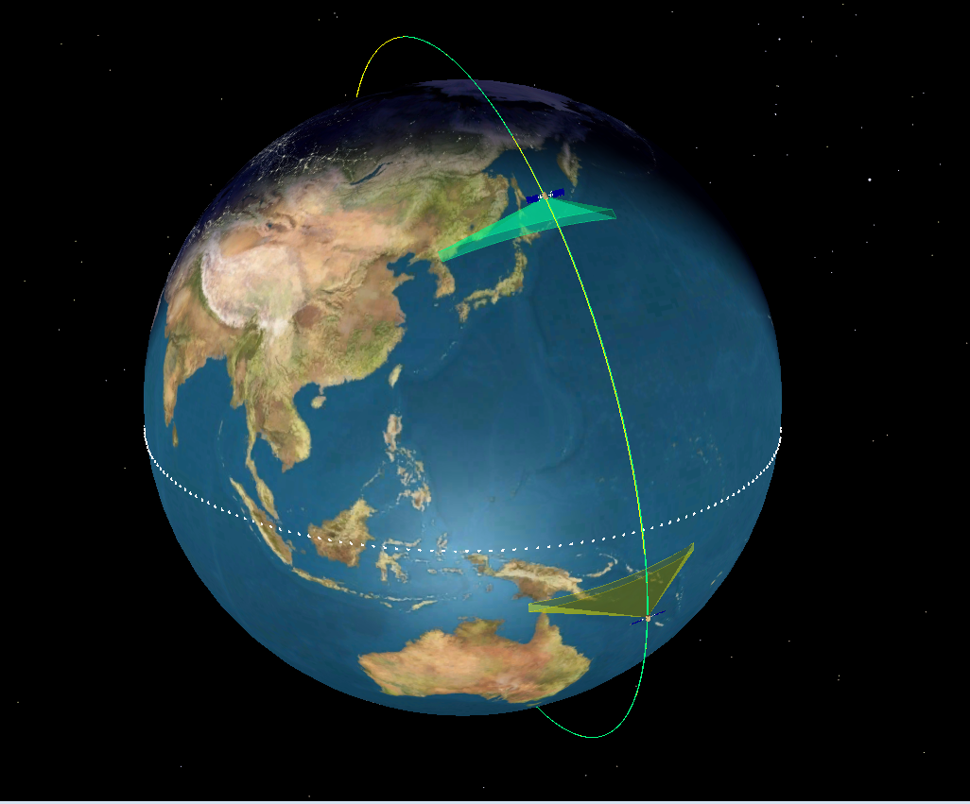
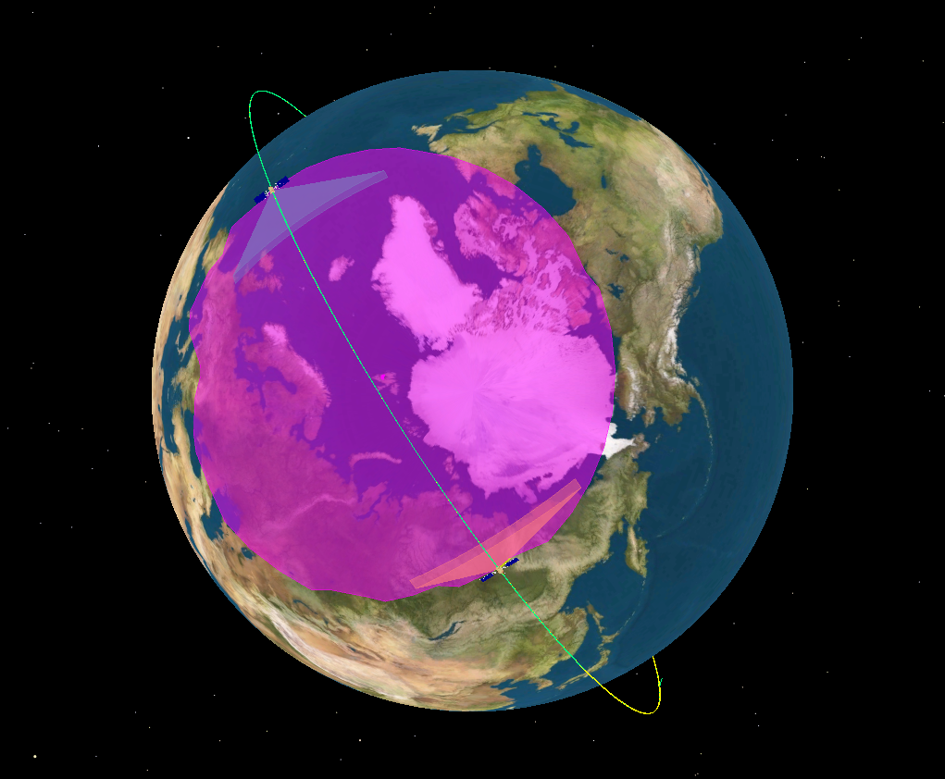
JPSS-1 Orbit and Constellation View
Part of JPSS satellite constellation at 824 km and 1330 LTAN, polar sun-synchronous orbit
16 day repeat cycle like S-NPP
JPSS-1 leads S-NPP with a minimum of 20 min orbital separation
Support instrument calibration using cross reference
Avoid ground contact conflicts
Working with GSFC A-train personnel and are preparing for meetings with JPSS Flight/LV to start coordination of mission orbit insertion
Cross different node at
same LTAN
JPSS-1
227 nodal crossings
JPSS-1
Svalbard
13:30
LTAN
S-NPP
S-NPP
Snapshot taken at time when both
spacecraft above Svalbard horizon
(magenta colored circle)

Slide 24
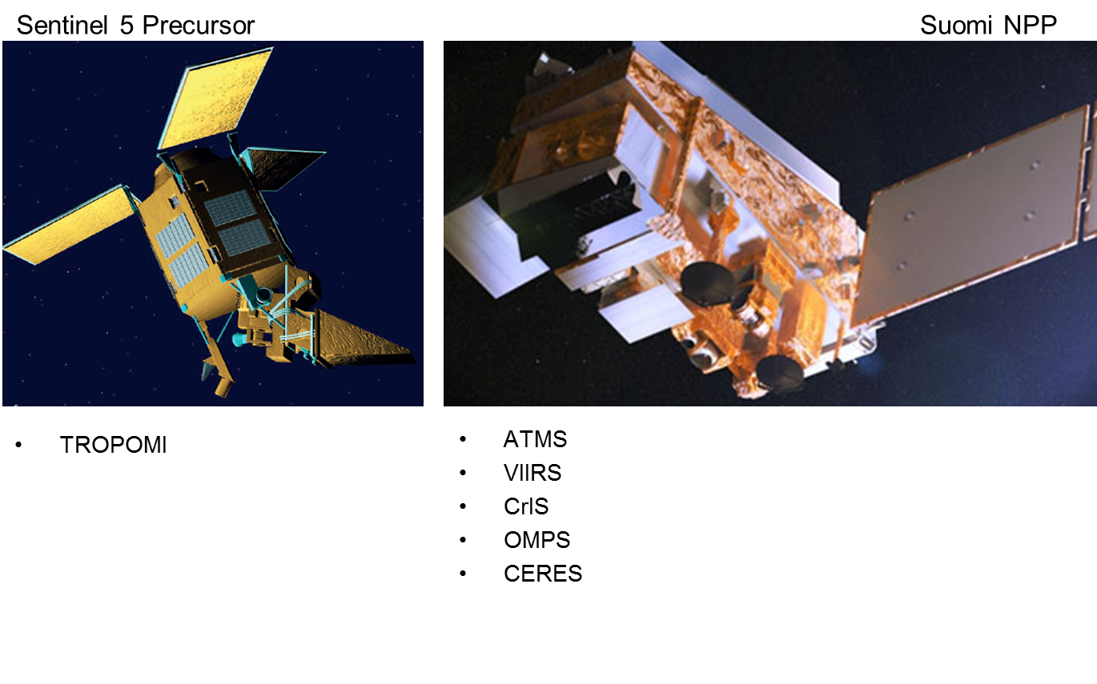
Potential ESA-NASA-NOAA Collaboration:
Sentinel 5 Precursor – SNPP Convoy
Ozone
SO₂
UV Aerosols
50km x 50km NPP & J1
15km x 15 km J1 research
CO,CO2,CH4 (IR)
14 km
Clouds
Aerosol
750m x 750m
Ozone
SO₂
UV aerosols
NO₂
CO (NIR)
CH₄ (NIR
7km x 7km
Launch 2016

Slide 25
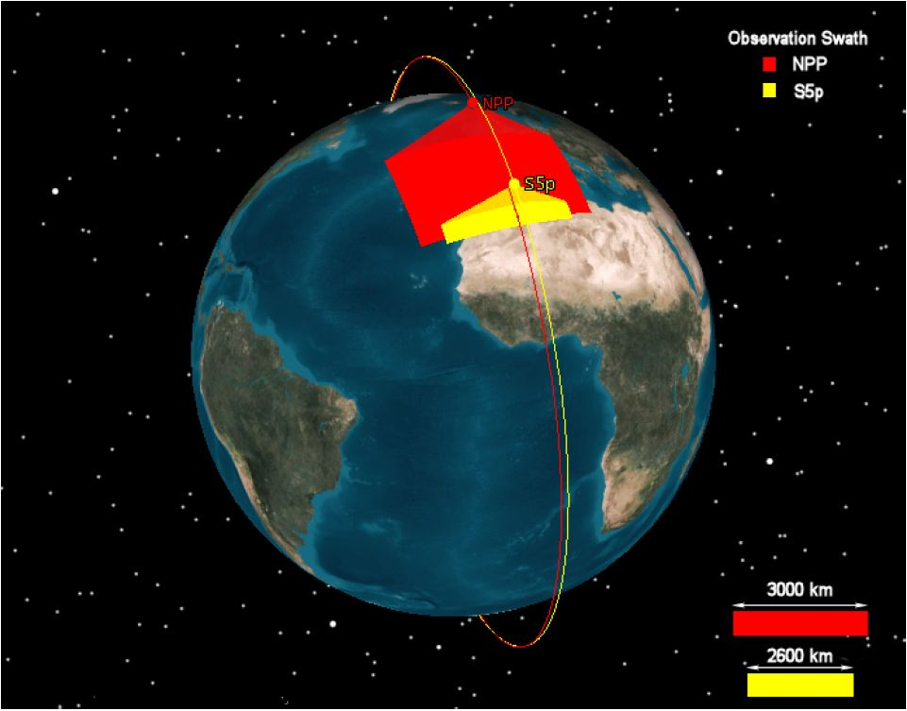
Joint Operation S-NPP & S5P
S5P In-Orbit Configuration
TROPOMI SWIR channel L2 processing (CH4 (, CO)) relying on accurate, high resolution cloud mask information
Phased operation with NASA’s Suomi-NPP envisaged (‘loose’ formation: separation 5 min +/- 5 min along track)
routine delivery of S-NPP/VIIRS products to PDGS
From: S5P-RP-ASU-SY-0011 (Mission Analysis)

Slide 26
S NPP - S5P Convoy Status
Convoy Planning: In progress.
ESA Ops - NOAA Ops ICD drafted
Simple exchange of orbital information planned
NOAA Operations staff is cautious and conservative and optimistic.
NASA-NOAA-ESA technical agreement in discussion.

Slide 27
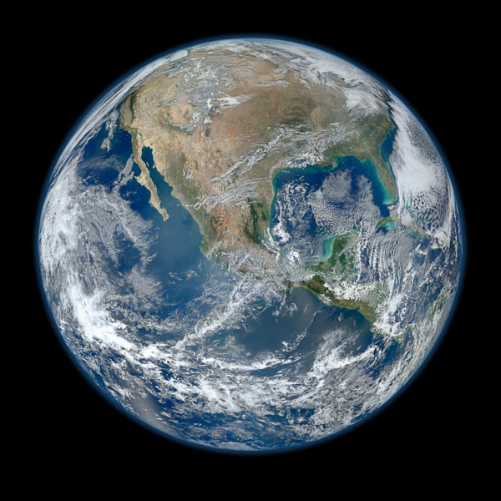
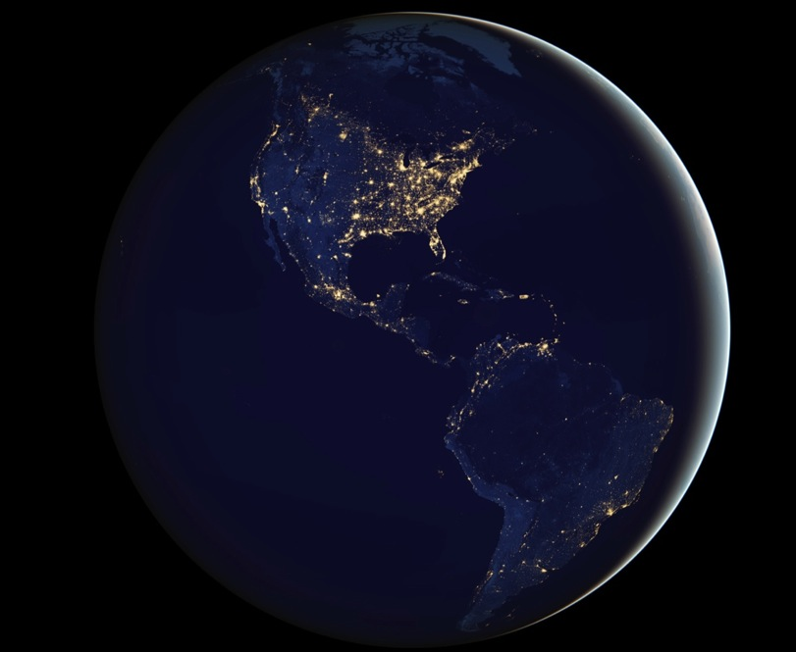
Questions?

Slide 28
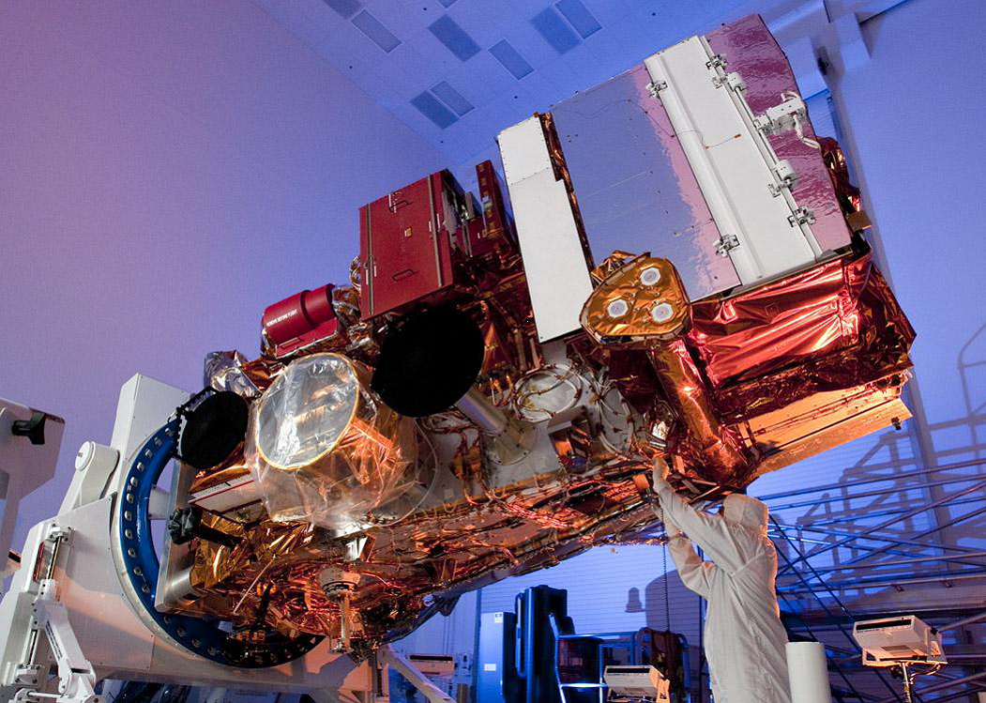
Suomi NPP Satellite
(nadir deck)
VIIRS
13.2 ft (4m) long
8.5 ft (2.6m) wide
4,500 lbs 2050 kg
CrIS
ATMS
TT&C
Ant.
OMPS
HRD
Ant.
CERES
SMD
Ant.

